Slide 1
Real-time rough refraction
Overview of fast algorithm for rough surfaces refraction computing invented by Charles de Rousier et al.
Prepared by Lukaš Krtek & Leonid Buneev.
Notes:
20s

Slide 2
BTDF
Light ray can be reflected, transmitted or absorbed.
Reflection => BRDF ($f_{r}$) – ‘R’ for Reflectance
Transmission => BTDF ($f_{t}$) - ‘T’ for Transmittance
Ideal model – specular BRDF and BTDF - easy to compute
Real life – more complex functions – need to integrate over whole hemisphere
BRDF integrates over “upper” hemisphere ($Ω^{+}$)
BTDF – over “lower” hemisphere ($Ω^{−}$)
$$L\left(p, ω_{0}\right)= \int_{Ω^{+}}^{ }{L\left(p,ω_{i}\right) f_{r}\left(ω_{o},ω_{i}\right)dω_{i} }+\int_{Ω^{−}}^{ }{L\left(p,ω_{i}\right) f_{t}\left(ω_{i},ω_{o}\right)dω_{i} }$$
Notes:
2 min

Slide 3
Specular brdf & btdf
Notes:
20s

Slide 4
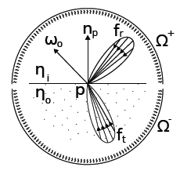
glossy brdf & rough btdf
Notes:
20s

Slide 5
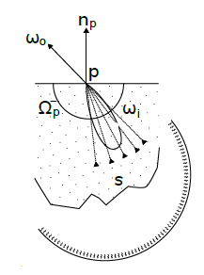
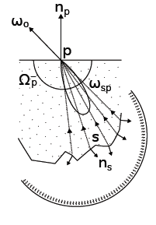
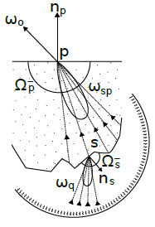
BTDF – integration over 2 surfaces

Slide 6
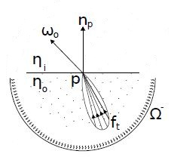
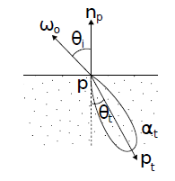
Pre-convolution
Goal: pre-compute incoming radiance at 2nd surface.
Possible only if BTDF is radially symmetric.
BTDF is approximated well by a spherical Gaussian:
We can pre-compute parameters for every $η$ and $1/η$ and store in 2D texture, indexed by $θ_{i}$ and ${κ_{γ}}_{}^{D}$:
Gaussian is symmetric, therefore environment map pre-convolution is possible.

Slide 7
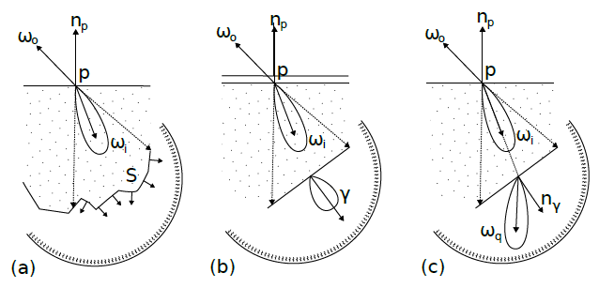
Light transport => Geometry filtering
Goal: approximate light transport inside object
Idea: Represent the geometry intersected at the second interface as a flat proxy enriched with NDF.

Slide 8
Algorithm: pre-computation
Pre-computation of parameters for Gaussian BTDF approximation
Stored as 2D texture for every index of refraction $η$ used
Pre-convolution of environment map with BTDF
Stored as mip-map with decreasing $κ$

Slide 9
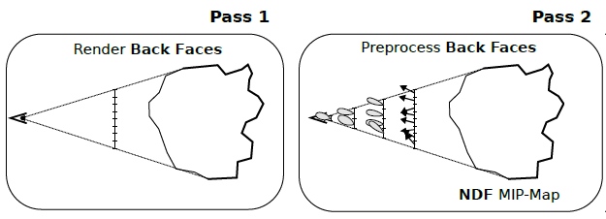
Algorithm: first & second pass
First pass:
Render back-facing geometry
Store depth & NDF
Second pass:
Create NDF MIP-map

Slide 10
Algorithm: third pass
Render front facing geometry
Compute refraction at the first interface
Trace a cone of the refracted rays inside the object
4 rays bounding 75% of BTDF
Use the NDF buffer (from 2nd pass) to retrieve the NDF approximating the intersection of the cone with back-facing geometry
Read incoming radiance from pre-convoluted environment map

Slide 11
Q&A

Slide 12
video

